Slide 1
Lists
Week 3

Slide 2
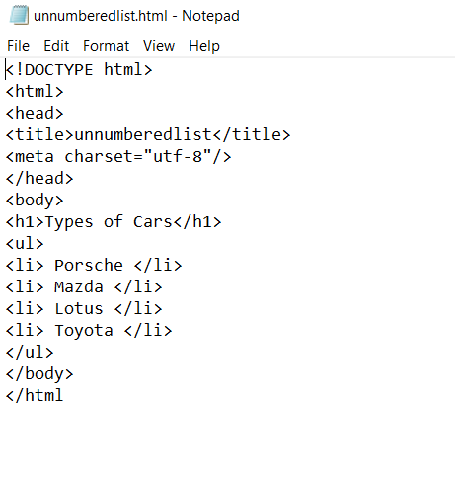
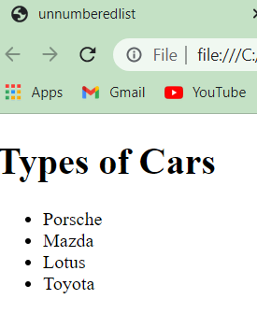
HTML allows the use of unnumbered, numbered, and definition lists. Unnumbered Lists
To create an unnumbered or unordered list
1. start with an opening list <ul> tag
2. enter the <li> tag followed by the individual item followed by the </li> tag.
3. end the entire list with a closing list </ul> tag.
Below is a sample unnumbered list:
Each <li> item can contain multiple paragraphs which can be separated using <p></p> tags.

Slide 3
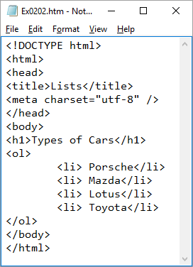
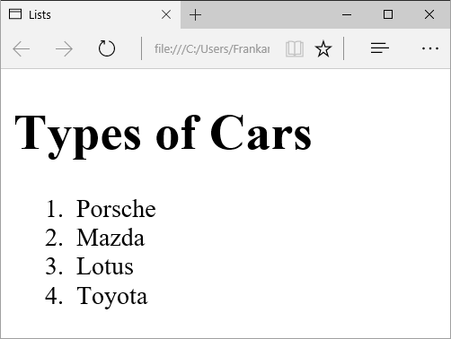
Ordered Lists
An ordered or numbered list is the same as an unnumbered list, except it uses <ol> instead of <ul>.
The items use the same <li> tag. The following XHTML code results in the following output.

Slide 4
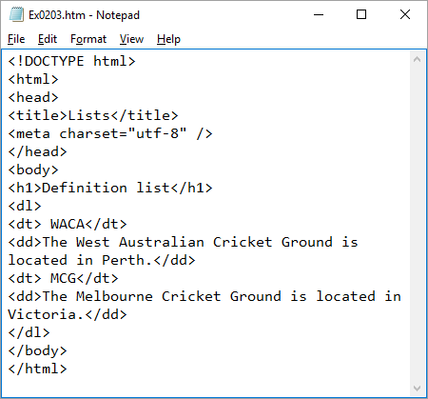
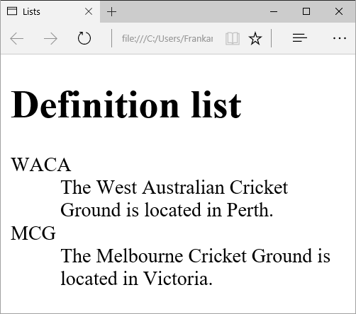
Definition Lists
A definition list uses the <dl></dl> tag pair and consists of a series of definition terms using the <dt></dt> tag pair and a definition using the <dd></dd> tag pair. The term is usually placed on one line by the browser and the definition indented on a new line.
The following is an example of a definition list:
The <dt></dt> and <dd></dd> entries can contain multiple paragraphs (indicated by <p></p> paragraph tags), lists, or other definition information.

Slide 5
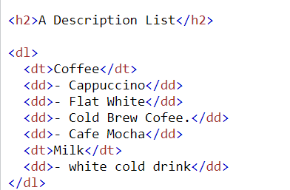
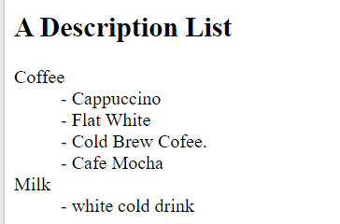
HTML Description Lists
HTML also supports description lists.
A description list is a list of terms, with a description of each term.
The <dl> tag defines the description list, the <dt> tag defines the term (name), and the <dd> tag describes each term:

Slide 6
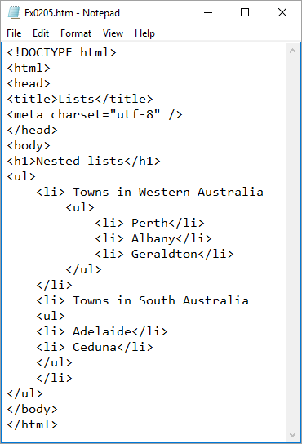
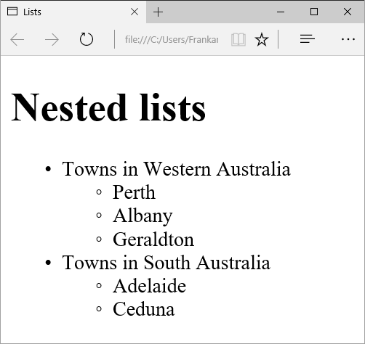
Nested Lists
Lists can be put inside other lists. This is called nesting. You can also have a number of paragraphs, each containing a nested list, in a single list item.
Only use this feature when it is absolutely required as too many nested items can get difficult to follow.
Here is a sample nested list:
Notice that the code in the left image has been indented. This has no functional value in terms of what is seen in the browser but does allow for easier reading of the code. The code for the first nested list is also easier to read than the code for the second

Slide 7
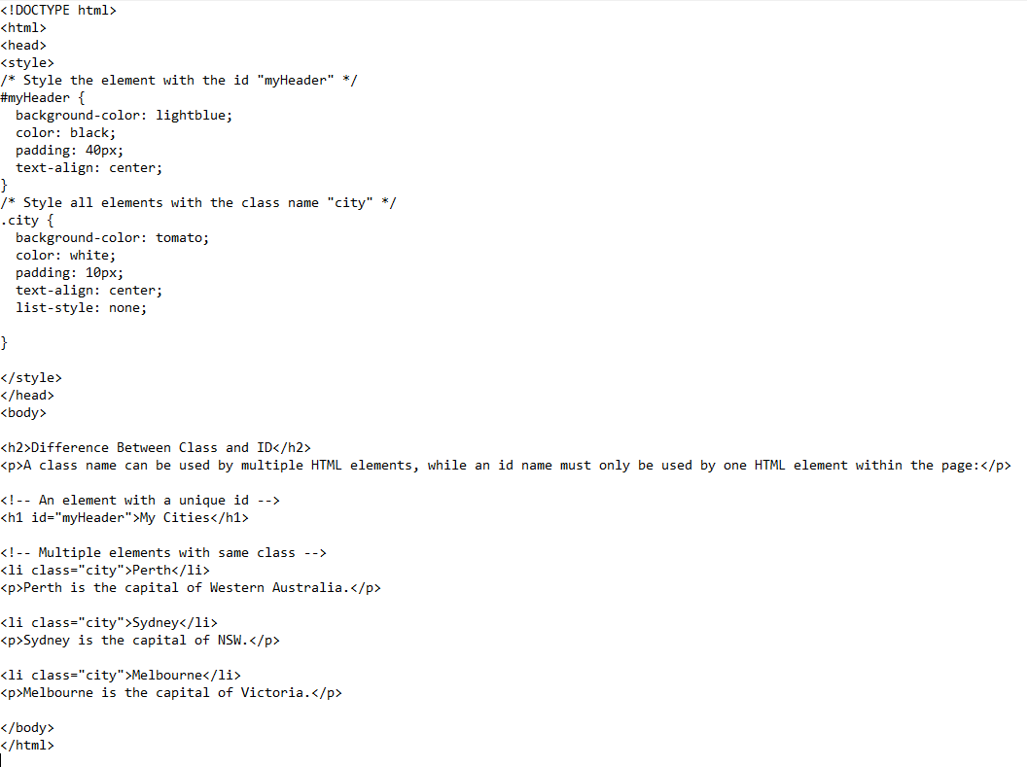
Using Lists and style (CSS inside HTML)
ID – To make it unique tag and apply the style
Class – To group the similar tag to apply the common style

Slide 8
